Slide 1

World Bank of CO2
PRESENTED BY: PRATEEK SAINI
Date: July 24th,2022

Slide 2
CONTENT:
Purpose
Data
Conclusion

Slide 3
Objective
Analysing the amount of CO2 in atmosphere in every region of world.

Slide 4
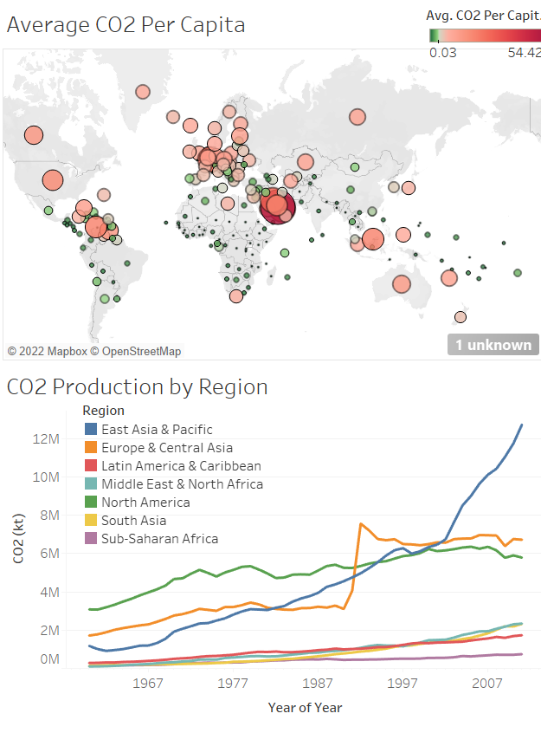
Geographic
Average CO2 produced by 1 person in each country in year 2022.
CO2 production increase yearly in different regions.

Slide 5
Conclusions
Rapid increase in the CO2 in East Asia and Pacific region which is an alarming stage for humans.
Steps taken by Europe and Central Asia to reduce CO2 seems to be very efficient as seen in year range(1987-97).
3 Regions have consistently been maintaining the CO2 level at the lowest respectively.

